Slide 1





Vroom Boom or Doom?
A data analysis exploring if 2018* was a good time to buy a used car.
* 2018 was the last year of our dataset.

Slide 2
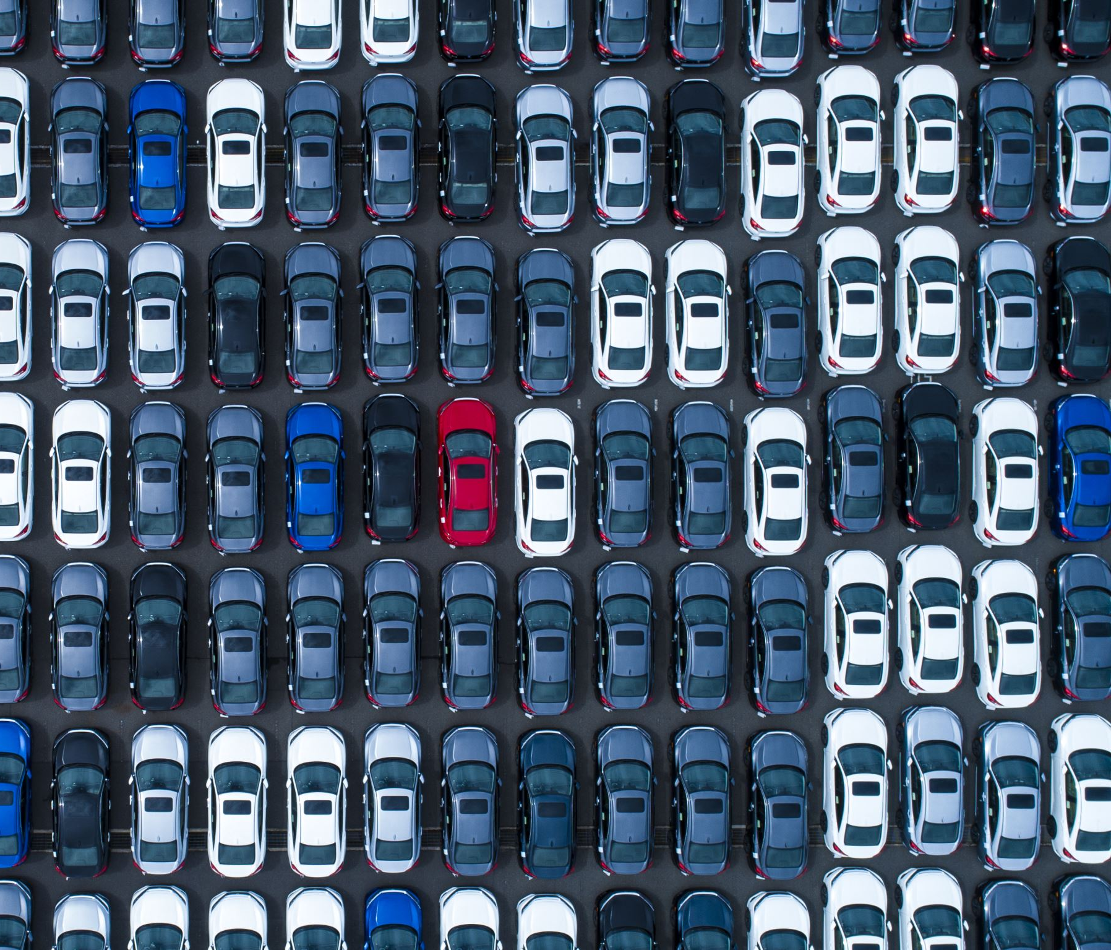
Research Question: Was 2018 a good time to buy a used car?
Sub questions:
Will used car price go up or down?
Will interest rates (financing) go up or down?
How do prices compare to household income?
Are there states where its better to buy a car than others?

Slide 3
Main Findings
2018 was not a good year to buy a used car:
Used car prices were on the upswing.
The average cost of a car compared to per capita income was 55%, meaning an average family in the US would spend more than half of the annual income on a used car
Average annual interest rates, loan amounts, and loan length for used cars were at the highest they were in 10 years, leading to an average total cost (loan + interest over length of loan) of $XX,XXX.
Still, if you had to buy a used car in 2018, it would make sense to travel to [STATE], where used car prices were the lowest.

Slide 4
Our Methodology and Assumptions
Our data came from Kaggle.com and the Federal Reserve Bank of St. Louis (FRED).
We adjusted the prices for inflation using 2018’s annual inflation rate.
We assumed our original data was accurate and authentic.
We assumed that the averages of our data would reflect an accurate picture of the used car market in 2018.

Slide 5

Will used car price go up or down?
Point 1
Point 2
Point 3?

Slide 6
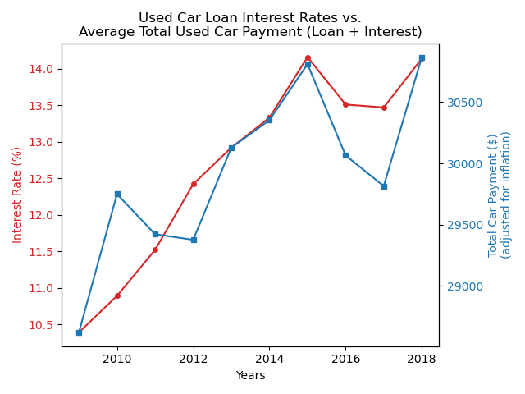
Will interest rates go up or down?
Average annual interest rates for used cars have been climbing steadily since 2009. There was a dip in 2016 and 2017, but they rose to 2016 levels in 2018.
Average total car payments (which equal the average used car loan amount plus interest) dipped in 2011 and 2012 (while interest rates climbed). However, they rose sharply in 2013 and tracked closely with interest rate trends. There was a similar dip in 2016 and 2017, only to again rise sharply in 2018.
The data suggest that interest rates will continue to rise in 2019 following the previous trends, and total payments will follow suit.

Slide 7
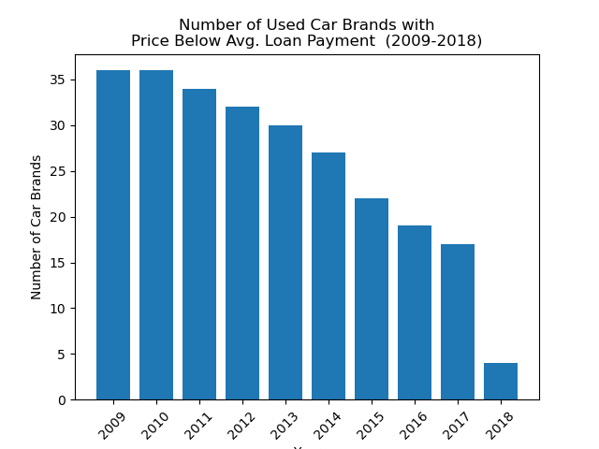
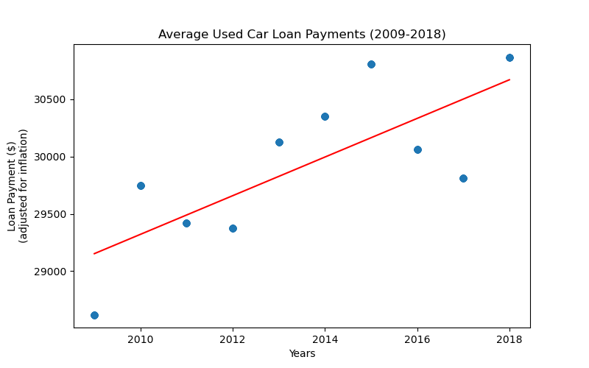
Will interest rates go up or down?
The total payment price for all used cars in our dataset generally rose slightly from 2009 to 2018. There were always outliers (your Rolls Royces, etc.), but even the price of more expensive used cars rose as well.
Looking at the average total payment price for ALL used cars by year, few brands had used cars that sold for less than or equal to that average total payment. The number of brands with used cars meeting that criteria declined as the years went on. In 2018, there were only 4 car brands whose used cars had a price (adjusted for inflation) that fell below the average payment price.

Slide 8
Will used car price go up or down?
Point 1
Point 2
Point 3?

Slide 9
Will used car price go up or down?
Point 1
Point 2
Point 3?

Slide 10
What we might be missing
Point 1
Point 2
Point 3?

